Slide 1

OC Transpo Bus Allocation Optimization
MECH 5800
Jessica Chiappetta
Joseph McConkey
Notes:
- Intro:o

Slide 2
Motivation
Public transportation is a critical component of a functioning metropolitan system
Key benefits include:
Road and Infrastructure | Social and Environmental
Reduced traffic congestion Reduced parking demand Fewer traffic accidents Lower road and parking infrastructure costs | Improved mobility for non-drivers Greater equity for those who cannot drive (people with disabilities, seniors, youths, immigrants, etc.) and low-income populations Health benefits from increased active transportation Reduced GHG emissions and improved air quality
RESULT: Motivation to improve bus frequency to increase ridership within budget constraints (O-Train expansion and post COVID-19 ridership impacts)

Slide 3
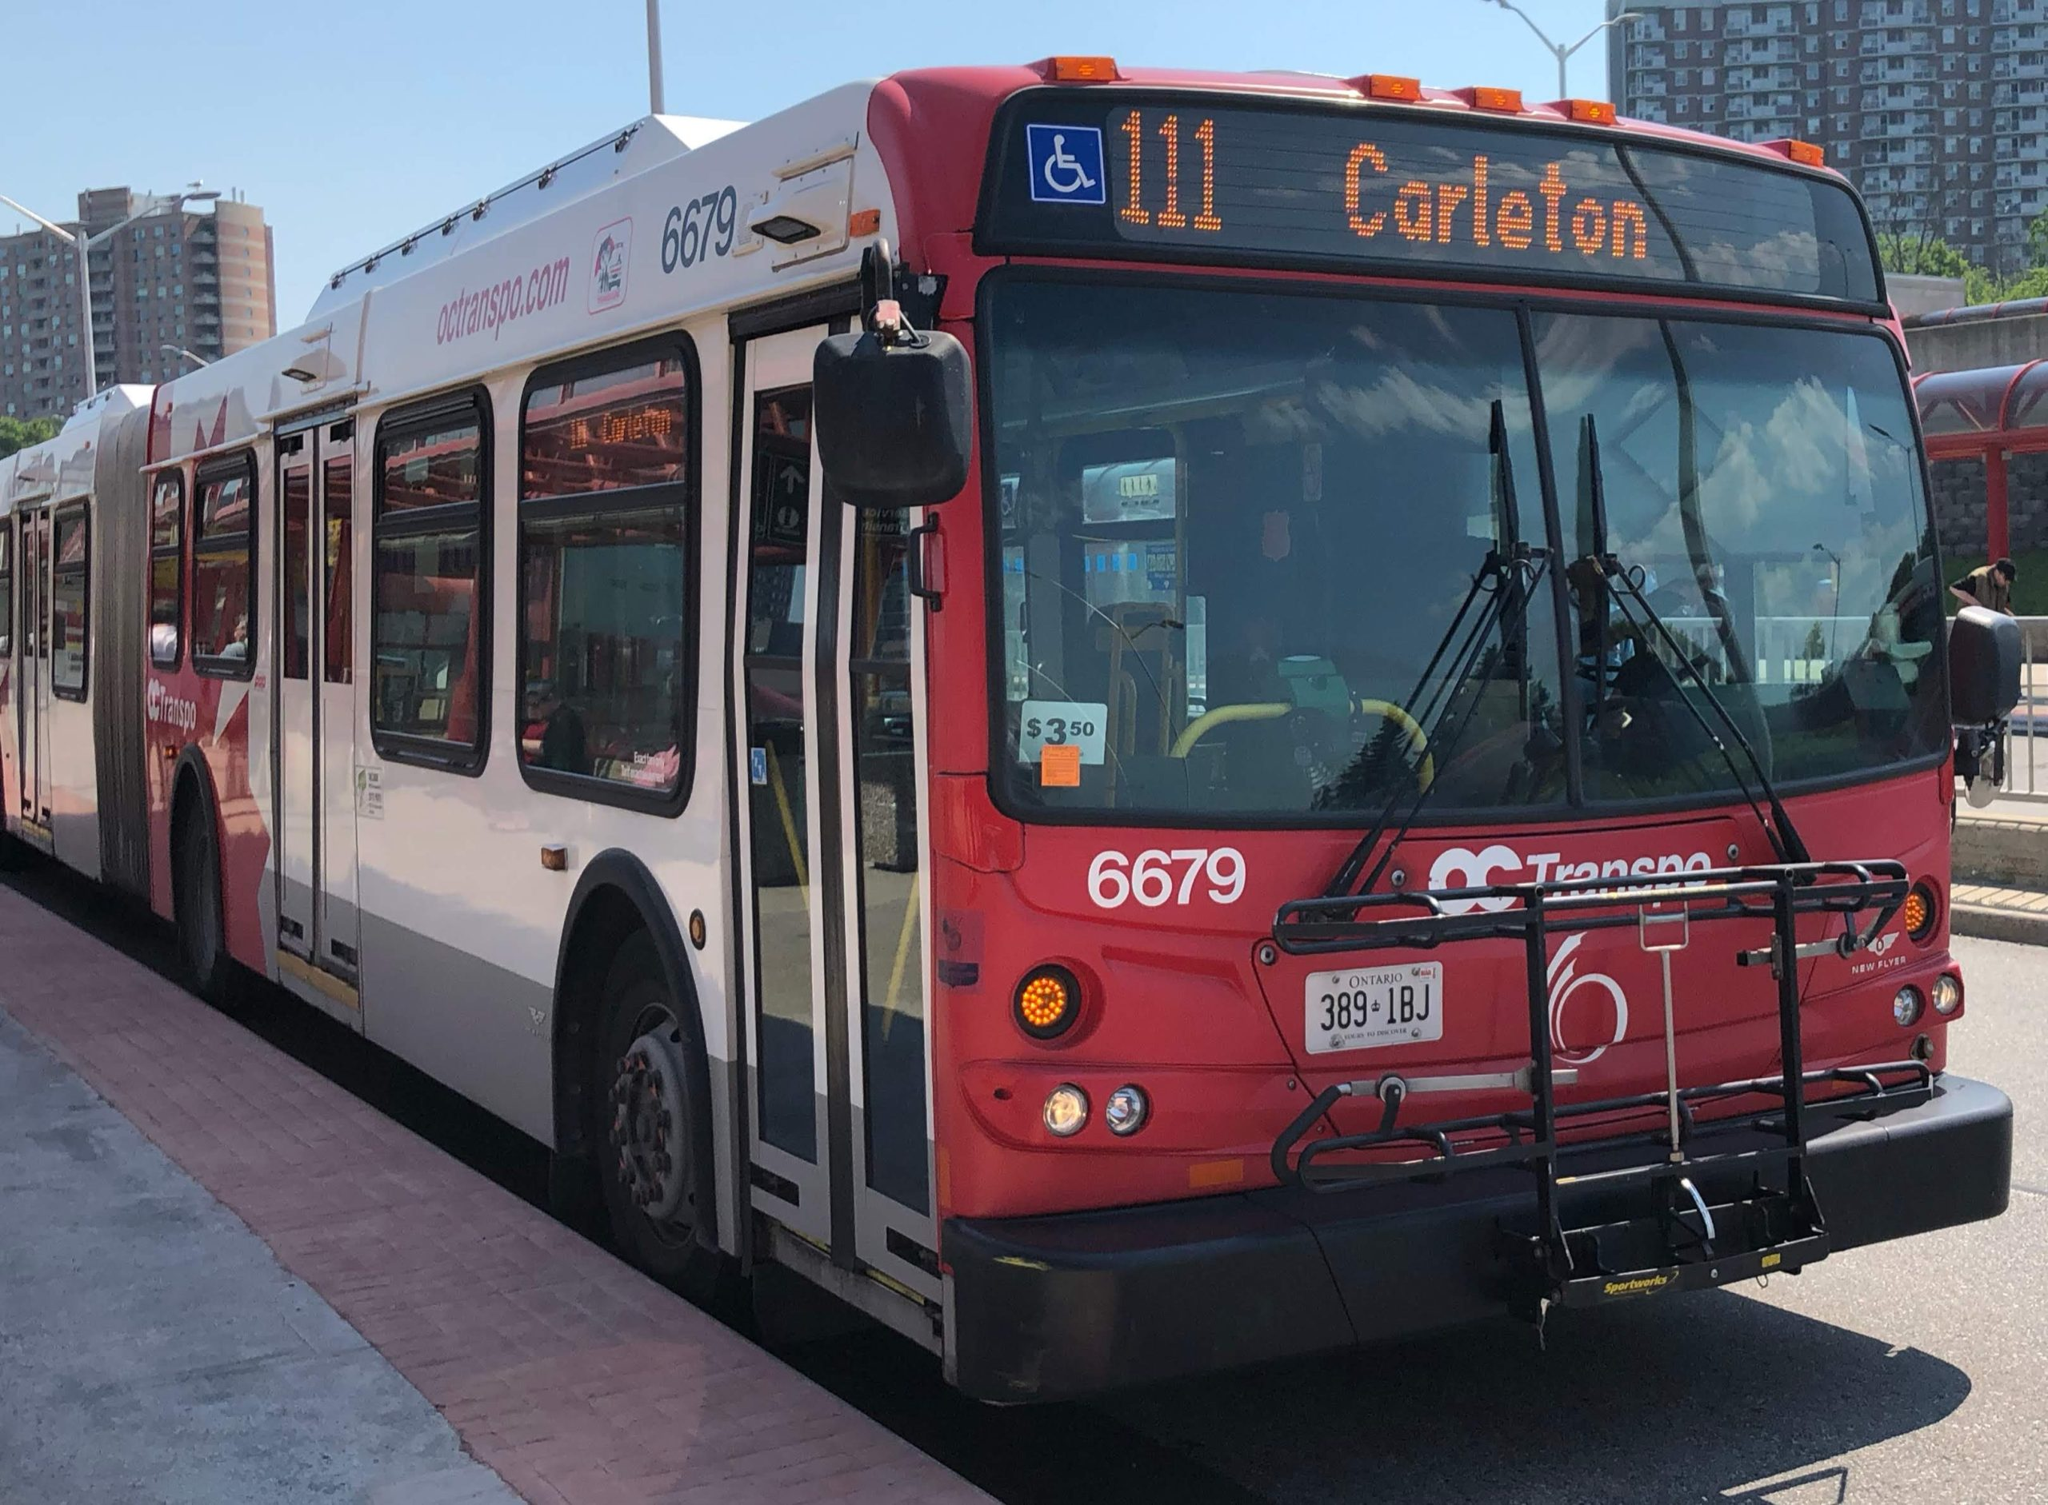
Objectives
Evaluate public transit benefits using non-market valuation techniques
Develop a cost-benefit analysis to quantify the impacts of changes in service frequency
Optimize route frequency across selected OC Transpo bus routes to maximize social benefits
Conduct sensitivity analysis to address uncertainty and identify key parameters influencing results

Slide 4
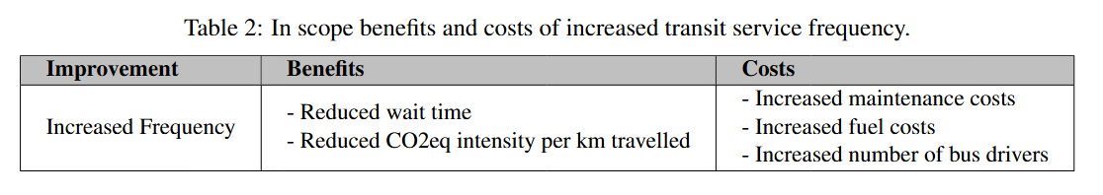
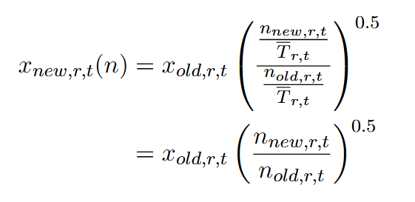
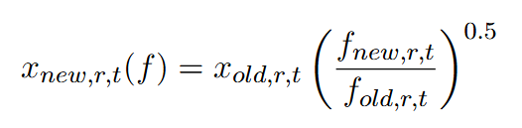
Scope and Frequency Effects
Elasticity of transit use with respect to transit service averages 0.5:
Service frequencies of optimized and current system
Integer problem
Number of passengers in optimized system
Number of passengers in current system
Number of buses in optimized and current system

Slide 5
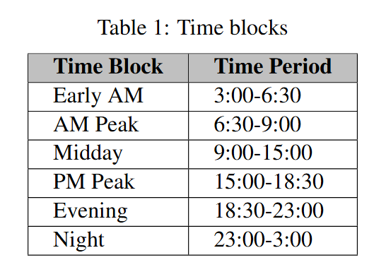
Data Sources
Ridership data
2023 ridership data categorized by route, time of day, and season
January selected as the representative study period
Passengers counts aggregated over time blocks
Route data
General Transit Feed Specification (GTFS)
Standardized format for public transit data
Provides schedule and geographic information for routes and stops
Used to represent current (2026) system operation
Optimize n_new -> number of buses for a given time block t, and route r

Slide 6
Cost Equations
Number buses in optimized system
Number hours in time block, t
Average route trip distance in km
Price of fuel in $/liter
Number buses in current system
Hourly wage rate of bus driver
Average route trip length in hr
Fuel consumption in liters/km
Maintenance cost per km travelled

Slide 7
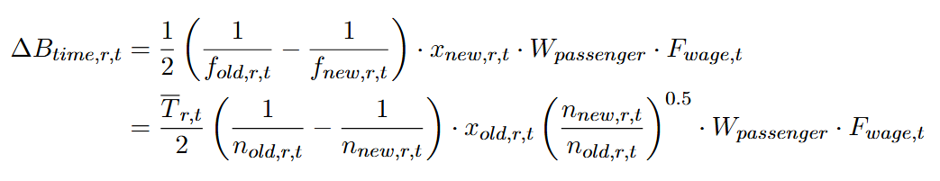
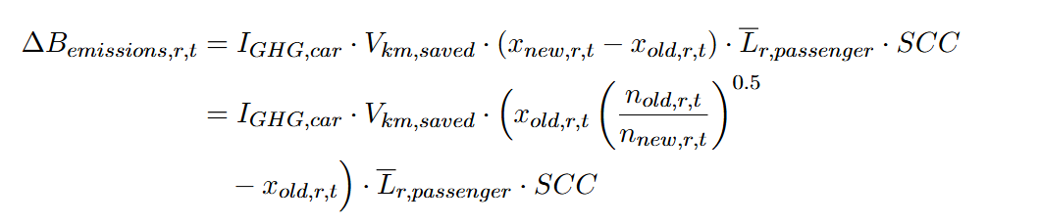
Benefit Equations
Average hourly wage rate of passenger
Fraction of hourly wage for VTT for passengers
Vehicle-kilometer saved per 1 km of transit passenger km travelled
Average length of passenger trip in km
Social cost of carbon in $/kg
Emission intensity of a vehicle in kg CO2eq/passenger km travelled

Slide 8
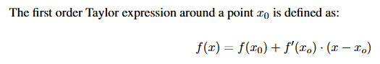


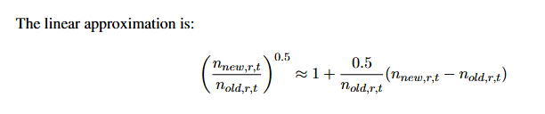
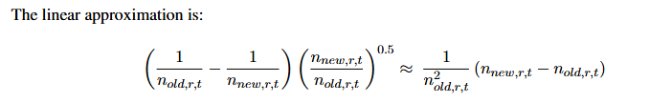
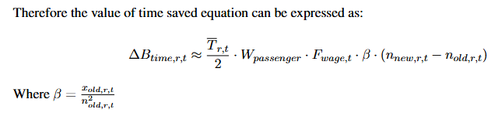
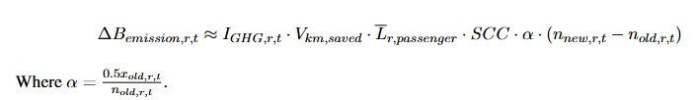
Linear Approximation
Non-linear Terms:
Non-linear Terms:
Taylor Expansion:
Taylor Expansion:

Slide 9
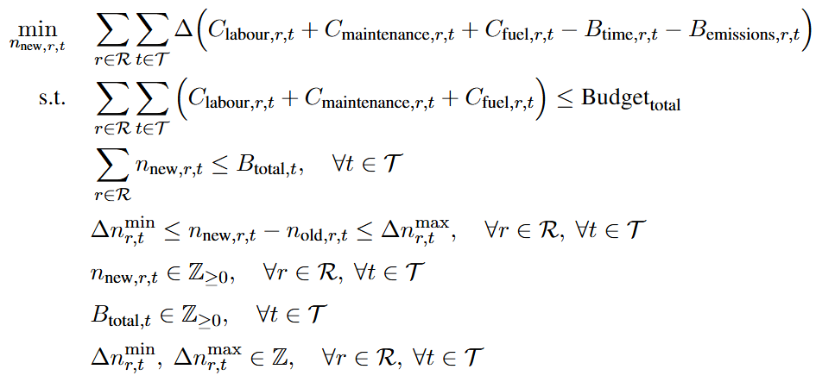

Global Minimization Formulation
New costs must not exceed a reasonable budget
Total bus assignments for a time block must not exceed an allowed total
The change in buses should not exceed some reasonable bounds (to maintain stability)
rϵR (85 routes)
tϵT (6 time blocks)
Integrality
=> 510 Decision Variables
(highly decomposable)

Slide 10
Solution Scope
Ridership (including baseline fleet size) determined based on our Jan 2023 data.
We constrained to weekday data since commuting to/from Carleton is our focus.
Route/Time blocks may be cancelled as dictated by the solver.
Using our linearization, we solved as a MILP using Gurobi.

Slide 11
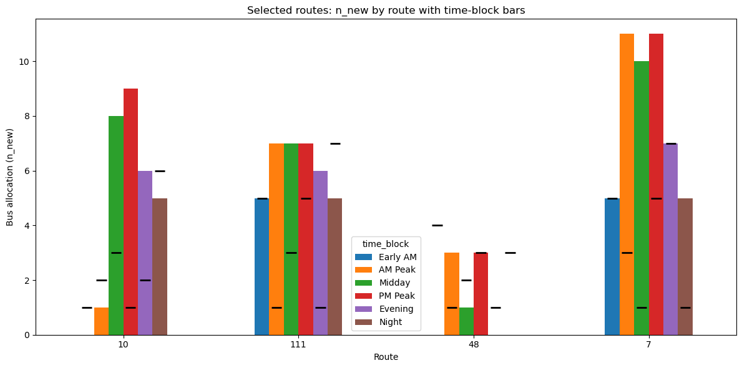
Results: Target Subset
Notes:
Here is the solution for our target subset.

Slide 12
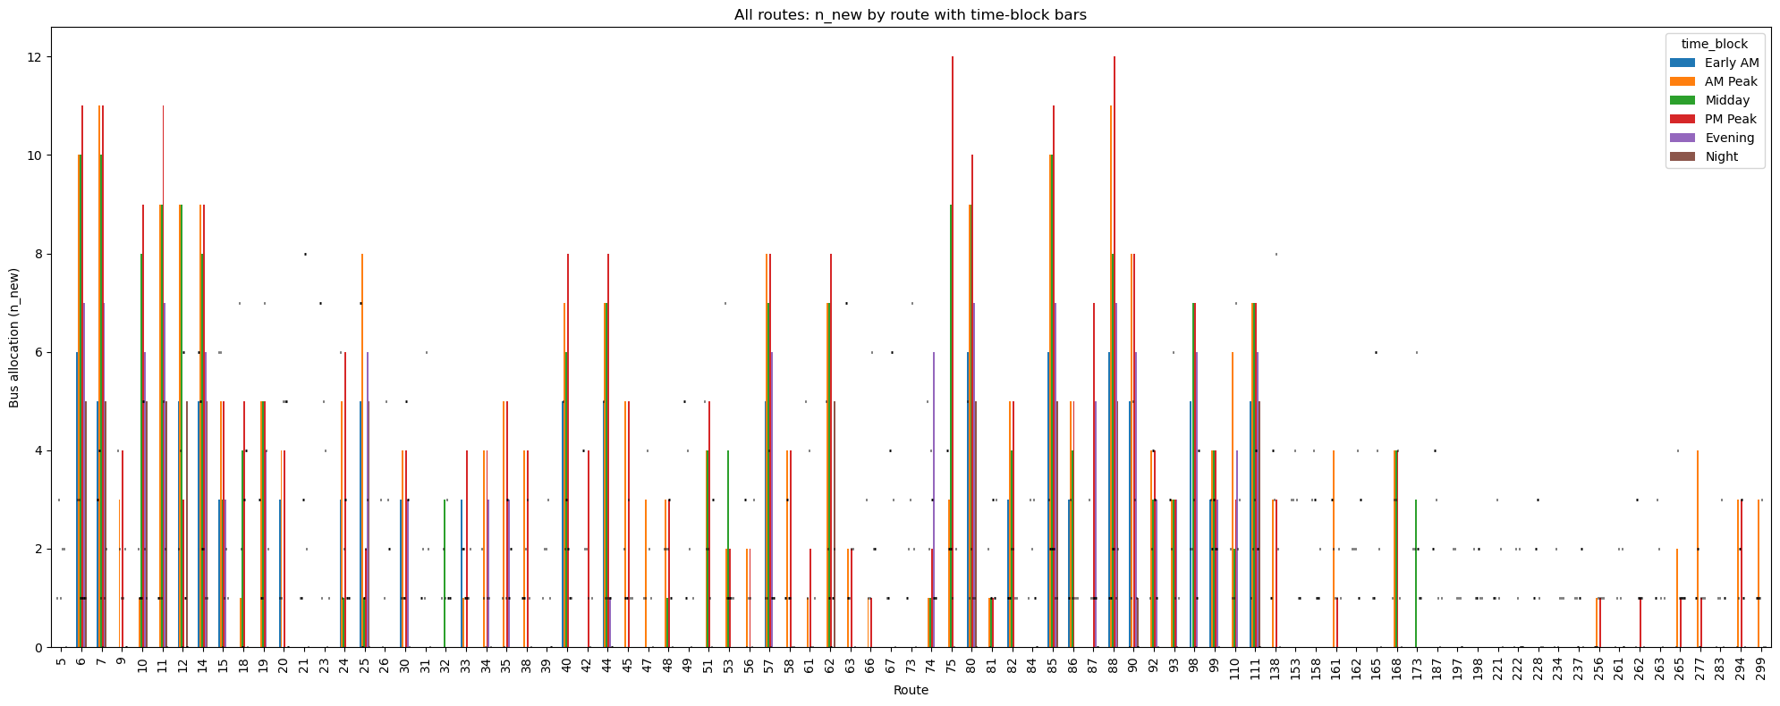












Results: Cancelled Routes
Notes:
The full solution looks like this. We can see that a number of routes are being cancelled.

Slide 13
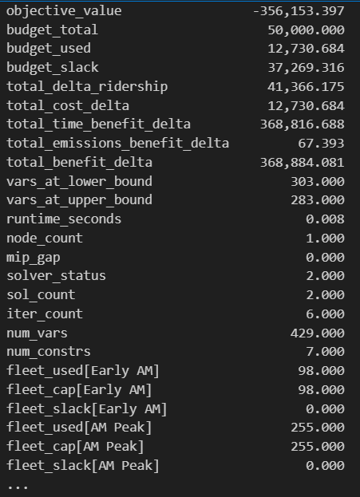















Results: Some Diagnostics
Benefits heavily outweigh costs
Slack in budget
MILP was very easy
Fleet constraints binding (across all time blocks)
Notes:
Here is the solution for our target subset.

Slide 14
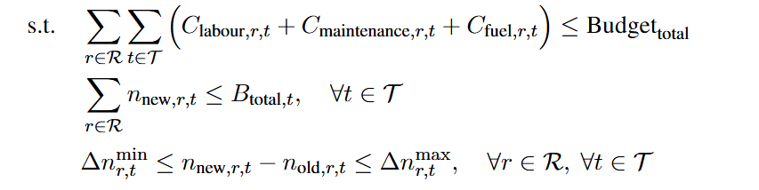
Sensitivity Analysis: Constraints

Slide 15




Notes on Fleet Estimation
As a baseline:
Then, we can introduce an expansion factor to represent increases to this fleet since 2023:

Slide 16
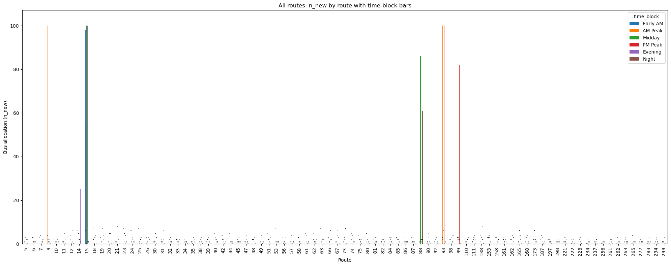
Notes on Fleet Estimation
We have also defined a maximum allowed change in buses.
Without this –> many routes outright canceled (as the routes in highest demand are assigned MANY buses):

Slide 17
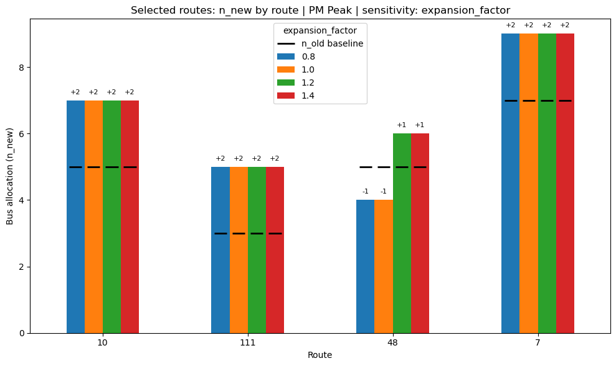
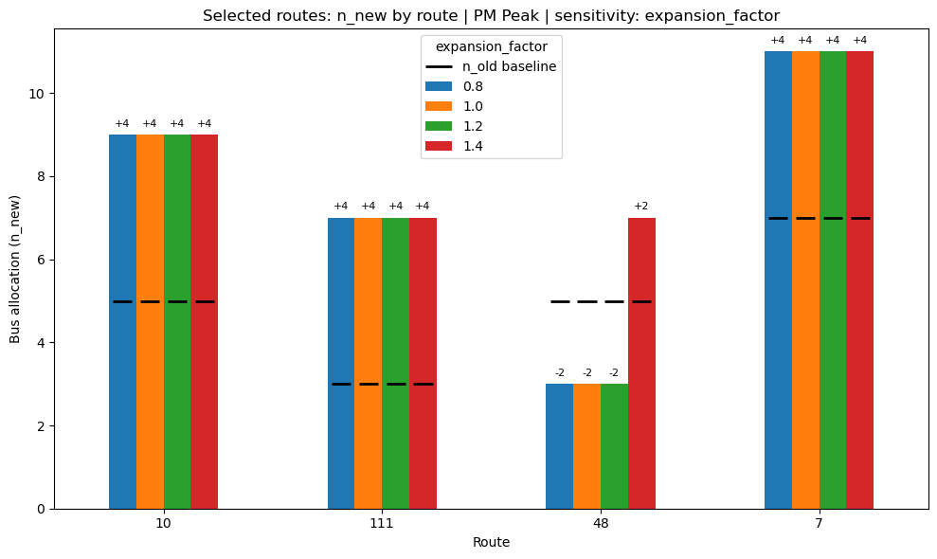

Fleet Scenarios
Within our target subset, we consistently use our headroom
Δn_new = 2
Δn_new = 4

Slide 18

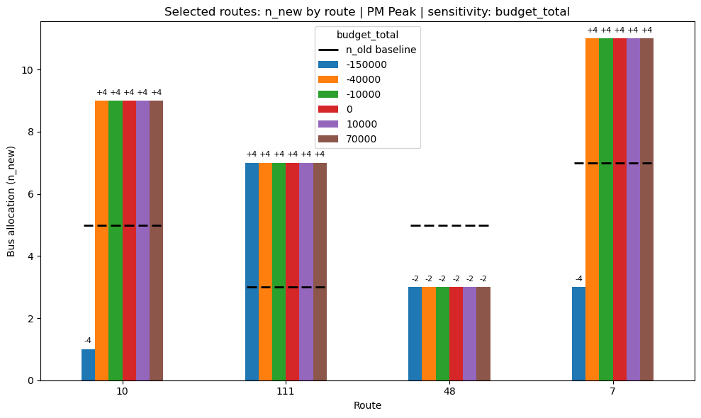

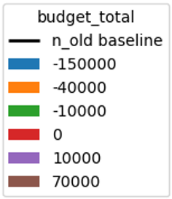
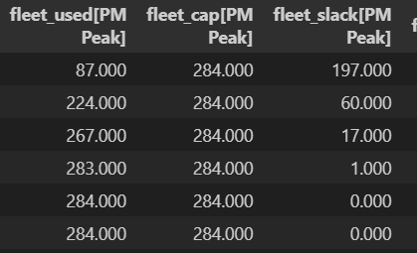













Budget Sensitivity
Fleet becomes non-binding at around $0
No change above ~$10,000. Fully bound by fleet constraints.

Slide 19

Budget Sensitivity
Budget is non-binding after ~$10,300.
It takes a substantial budget decrease or a high expansion factor to see meaningfully different results.
Let’s see if our model parameters are sensitive.

Slide 20
Sensitivity Analysis: Parameters
Driver horuly wage rate $/hr (W_driver) | Price of fuel $/litre (P_fuel) | Fuel consumption (FC) | Maintenace cost $/km (P_maintenance) | Passenger hourly wage rate $/hr (W_passenger) | VTTS fraction of passenger wage (F_wage) | Emission intensity of a car kgCO2eq/KPT (I_GHG,car) | Average Length of passenger trip (L_avg_trip) | Social cost of carbon $/tonne CO2eq (SCC) | Vehicle-miles saved per 1 km of passenger km travelled (V_km,saved)

Slide 21
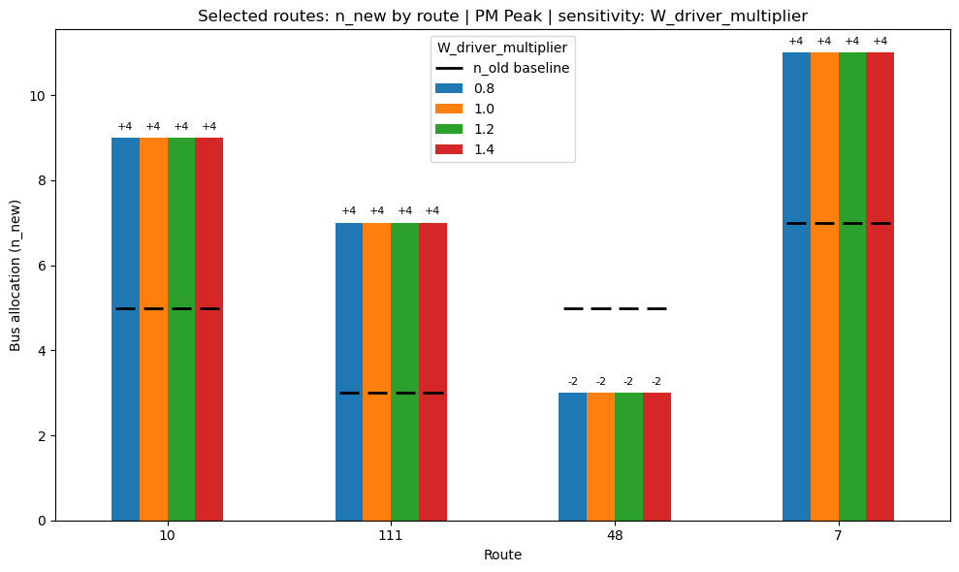




Slide 22





Slide 23



Slide 24
Sensitivity Analysis: Conclusions
Consistently, Carleton routes show improved bus frequency (barring Route 48 which suffers). Especially during Midday and PM Peak hours.
Our linearization skews the result, as it does not capture diminishing returns in ridership for large increases in bus frequency.
We ARE bound by our fleet constraints.
Results are insensitive to budget constraints
Results are generally insensitive to cost and benefit parameters within target time block.

Slide 25
Questions?

Slide 26
Questions?

